Slide 1
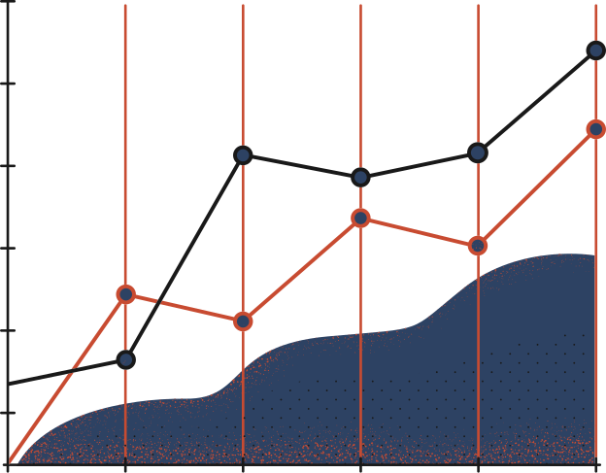


BAN 210 – FINAL ASSESSMENT
ANALYSIS ON BREAST CANCER DATASET
STUDENT
PROFESSOR
Dhananjay Kumar
135297208
Adeel Javed

Slide 2

I
INTRODUCTION
I analysed and predicted the class of the target variable from the breast cancer dataset using predictive modeling. The class variable which we will predicting consist of 85 occurrences of one class and 201 instances of another. Nine attributes, some of which are numeric and others which are nominal, are used to describe the instances in this dataset.
OBJECTIVE
Predict if the Target variable's value represents a "Recurrence Event" or a "Non-Recurrence Event"
Evaluate several models and determine which one is more accurate and performs better.

Slide 3

IV
STEPS INVOLVED IN THE ANALYSIS
File Import
Using the file Import option in the properties window, the file is uploaded.
Stat Explore
The stat explore node is added to study the class variable.
Graph Explore
The graph explore node shows the distribution of recurrence and non-recurrence events
Data Partition
The data is divided into Train and Validation sets in this stage.
Impute Node
The impute node is used to reduce the possibility of models ignoring the observation of missing values

Slide 4
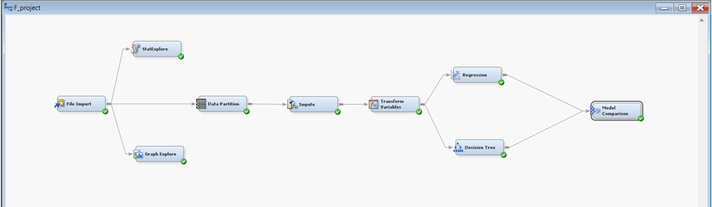
IV
STEPS INVOLVED IN THE ANALYSIS
Data Transformation
The variables for the model is transformed in this stage
Regression
Logistic Regression model is used as the first predictive model.
Decision Tree
Decision tree is used as the second predictive model
Model Comparison
Model comparison is used to evaluate the 2 models.
Notes:
In this step, I added the stat explore node in order to study the class variable. The below screenshot shows the results from Stat Explore node.
In order to identify whether the variables are independent of if there is a relationship between categorical variables. From the results, we can see the degree of malignancy, inv-nodes, and node caps are highly involved in decision making.

Slide 5
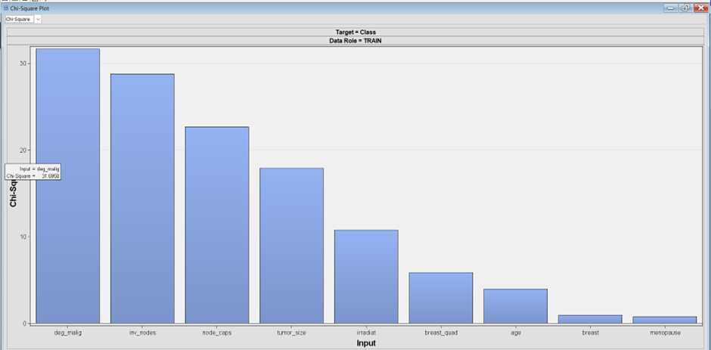
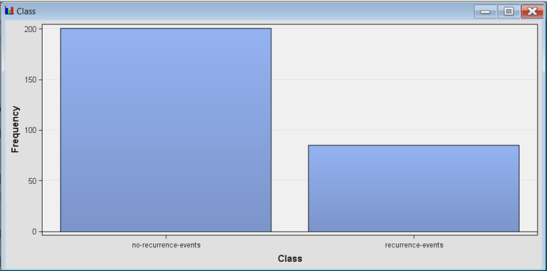
III
EXPLORATORY DATA ANALYSIS
From the results, we can see the degree of malignancy, inv-nodes, and node caps are highly involved in decision making.
We chose Class as the Target variable in our analysis
The graph above shows the distribution of recurrence and non-recurrence events
Frequency of Non-recurrence-events is higher than recurrence-events
9
Notes:
In this step, I added the stat explore node in order to study the class variable. The below screenshot shows the results from Stat Explore node.
In order to identify whether the variables are independent of if there is a relationship between categorical variables. From the results, we can see the degree of malignancy, inv-nodes, and node caps are highly involved in decision making.

Slide 6
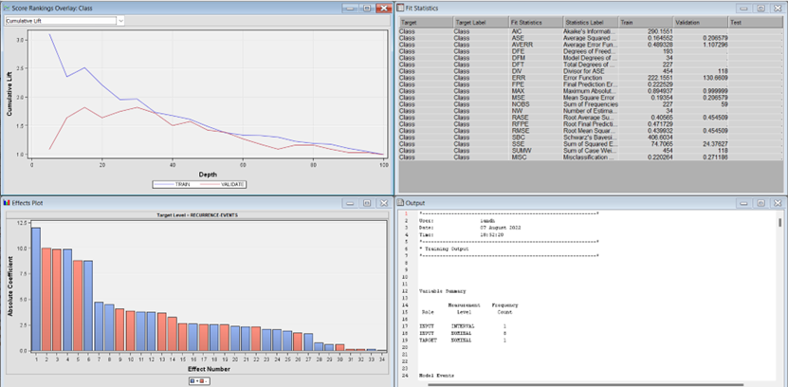
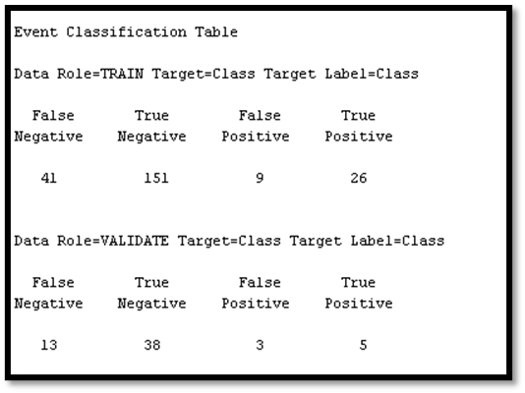
IV
LOGISTIC REGRESSION MODEL
Logistic regression is used since we are doing the prediction on a classification variable.
The above results show the Cumulative lift, Fit Statistics, Effects plot, and Event classification table of the Logistic regression model.
Notes:
Because we are doing the prediction on a classification variable, I am using logistic regression. The Logistic Regression node and the Data Transformation node are connected, and I have chosen Logit in the properties panel.

Slide 7
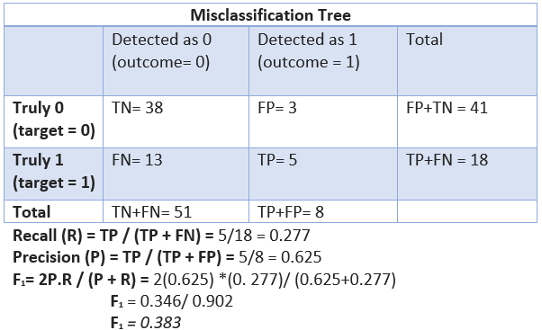
IV
LOGISTIC REGRESSION MODEL
The event Classification table of the logistic regression model yields the following results:
Recall: 0.277
Precision: 0.625
F1 Score: 0.383

Slide 8
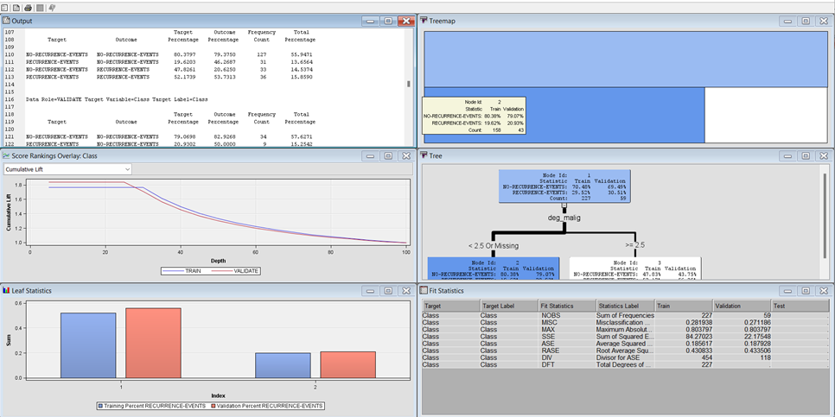
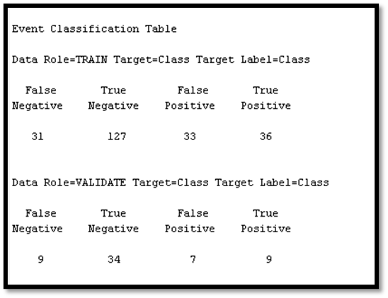
IV
DECISION TREE MODEL
The decision tree model is chosen as the second model.
The above results show the Output, Cumulative lift, Leaf Statistics, Tree, Fit Statistics, and Event classification table of the Decision tree model.

Slide 9
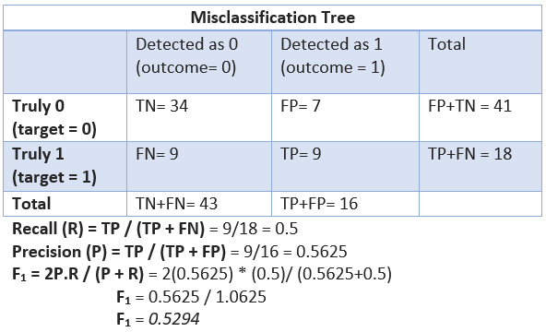
IV
DECISION TREE MODEL
The event Classification table of the Decision Tree model yields the following results:
Recall: 0.5
Precision: 0.5625
F1 Score: 0.5294

Slide 10
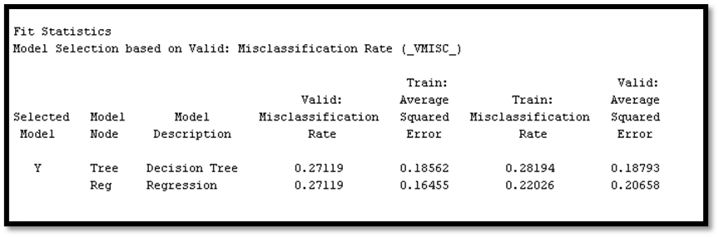
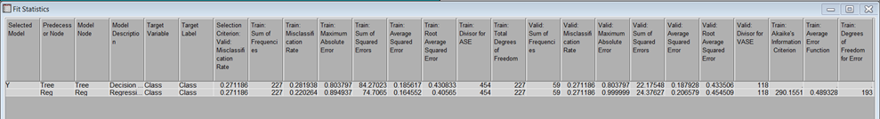
IV
CONCLUSION
The following metrics are compared between the two models: MSE, Misclassification Rate, Recall, Precision, and F1 Score. The Precision and F1 Score of the Decision Tree model are higher than those of the Logistic Regression model, making it better to the Regression model.

Slide 11

The End
Thank you

